Slide 1
BANK CRM ANALYSIS
TEJAS K R

Slide 2


CRM

Slide 3
Table of Contents
Problem Statement
Data Description
Date Schema
Observations
Key Insights
Dashboard
Conclusion

Slide 4
Problem Statement
You are an analytical CRM (Customer Relationship Management) specialist hired by a bank to extract meaningful insights from various customer-related datasets.
The bank aims to reduce customer churn, improve service delivery, and enhance customer satisfaction.
They have provided you with datasets including customer demographics, transaction details, customer exit information, and active customer profiles.

Slide 5
Data description
Row Number: The row number in the dataset, likely used for reference or indexing.
Customer Id: A unique identifier for each customer.
Credit Score: A numerical representation of the customer's creditworthiness.
Geography ID: A numerical identifier that likely corresponds to a geographical location, such as a country or region.
Gender ID: A numerical identifier for the customer's gender, where for example, '1' could represent male and '2' could represent female.
Age: The age of the customer.
Tenure: The number of years the customer has been with the bank.
Balance: Current balance in the customer's account.

Slide 6
Data description
Num Of Products: refers to the number of products that a customer has purchased through the bank.
Has Cr Card: denotes whether or not a customer has a credit card. This column is also relevant, since people with a credit card are less likely to leave the bank.
Is Active Member: active customers are less likely to leave the bank (as per the criteria defined by the bank for identifying the activeness).
Estimated Salary: as with balance, people with lower salaries are more likely to leave the bank compared to those with higher salaries.
Exited: whether or not the customer left the bank.
Bank DOJ: date when the Customer associated/joined with the bank.

Slide 7
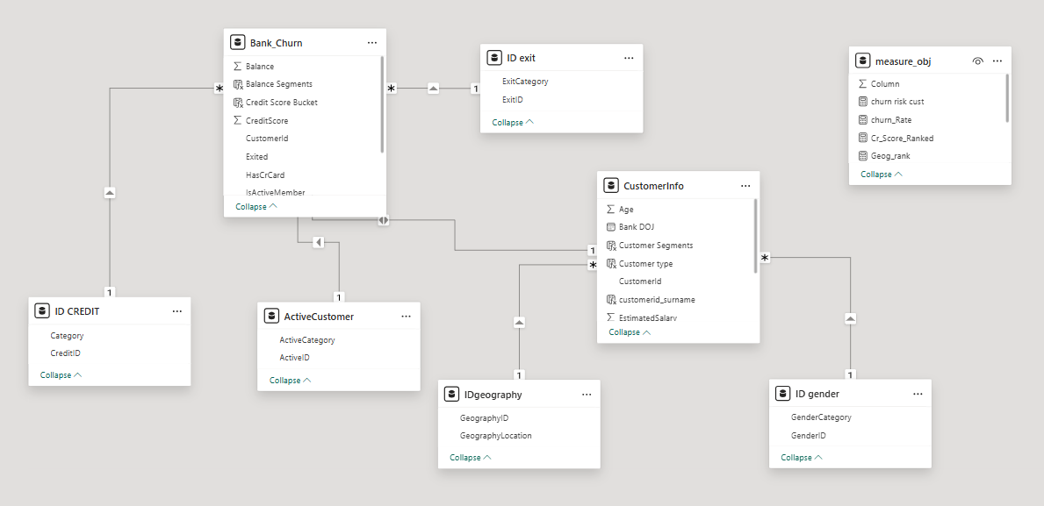
DATABASE SCHEMA

Slide 8
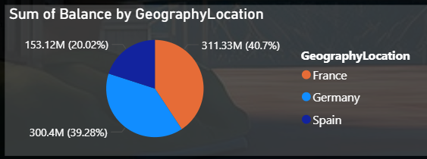
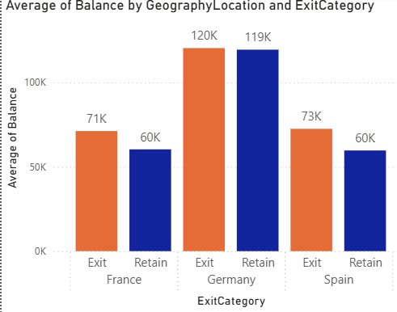
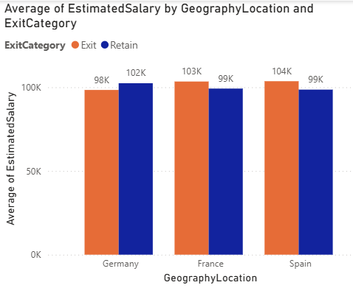
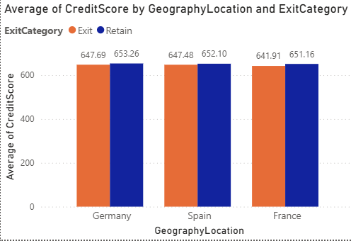
Total Balance of customers in each Region

Slide 9
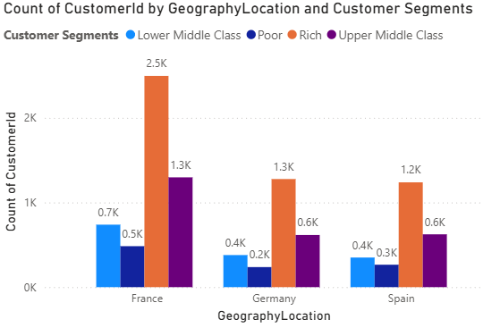
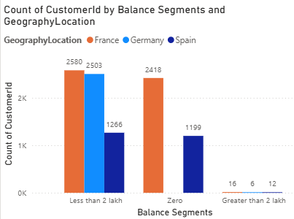
Count of customer by location and customer segment

Slide 10
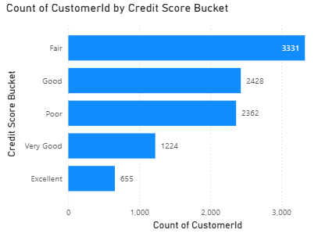
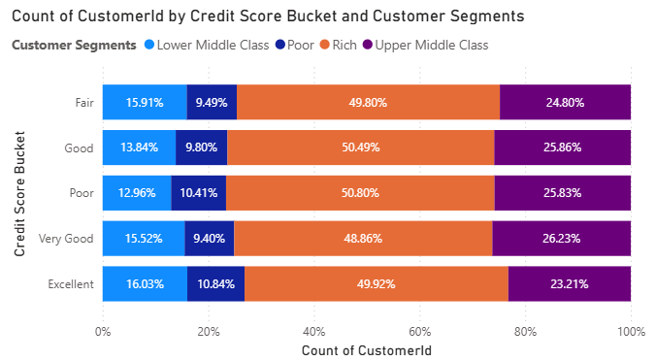
Churn Risk Management Assessment
Rich Segment Dominance – The Rich segment holds the largest share across all credit score buckets.
Lower Middle Class & Poor – These segments have the smallest shares.
Upper-Middle Class Stability – This segment remains fairly consistent .
Credit Score Distribution – Customer segments remain stable across credit scores, indicating no major shifts in composition.

Slide 11
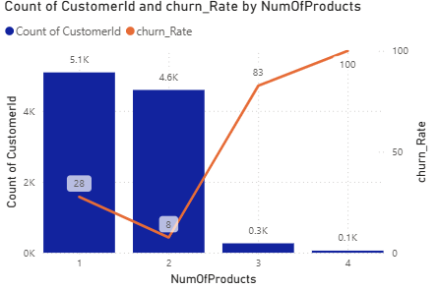
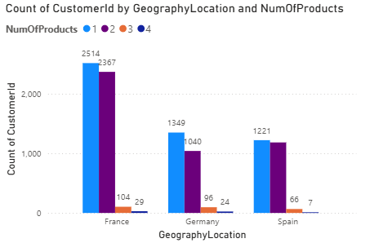
Total Customers and Churn Rate VS Num of Products
Customers who purchased 4 products have the highest churn rate at 100%, which steadily decreases as the number of products purchased decreases.
Additionally, the majority of customers have purchased only one product, with the number of customers decreasing as they buy more products..

Slide 12
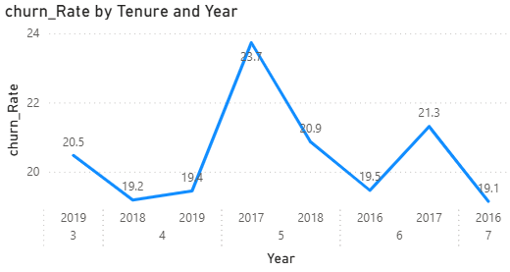
Churn rate Analysis
Peak Churn Observed in 2017 (Tenure 5): The churn rate reached its highest point at 23.7%, indicating a significant customer drop-off around the mid-tenure stage. This suggests a potential engagement or satisfaction gap during this period.
Fluctuating Trend Across Years: Churn rates vary between 19% and 21% for most tenure groups, showing moderate volatility rather than a consistent upward or downward pattern.
Lower Churn at Higher Tenure Levels: For tenure 6 and 7, churn stabilizes around 19–21%, implying relatively better retention among longer-tenured customers compared to mid-tenure customers.

Slide 13
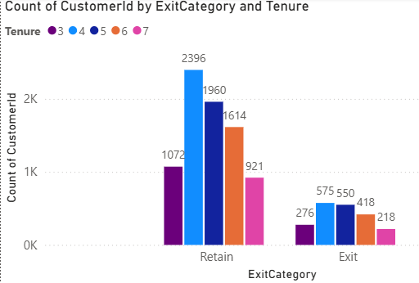
Total customers vs Tenure
Customers with tenure greater than or equal to 4 years show significantly higher retention rates.
At 4 years of tenure, 2,396 customers are retained, with 575 exits.
At 5 years of tenure, 1,960 customers are retained, with 550 exits.
Retention consistently remains high as tenure increases.
In contrast, customers with tenure of 3 years or less have a relatively higher churn rate:

Slide 14
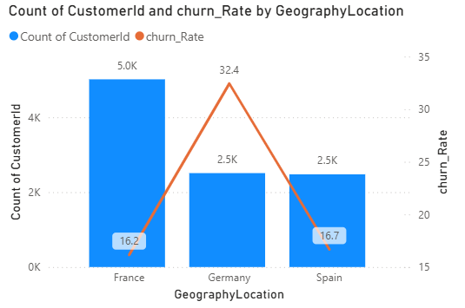
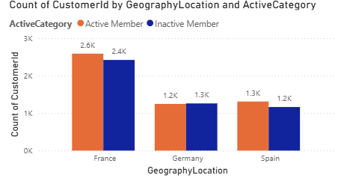
Region VS Total Customers and Churn Rate
In France: Highest active members (5.0K) and low churn rate (16.2%).Strong retention.
In Germany: High churn rate (32.4%) despite fewer active members (2.5K). Retention challenges.
In Spain: Same active members as Germany (2.5K) but lower churn rate (16.7%). Stable retention.

Slide 15
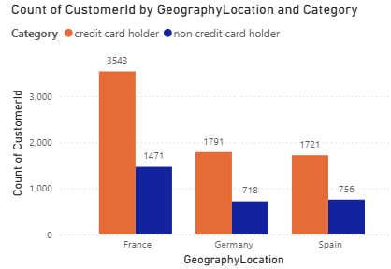
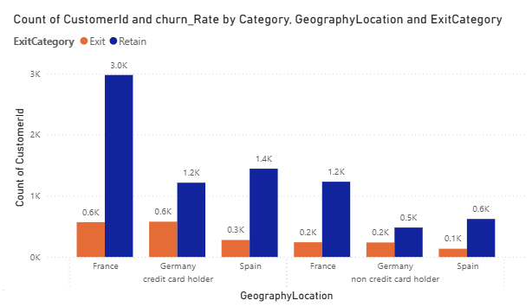
Total customers with Credit Card and No Credit Cards

Slide 16
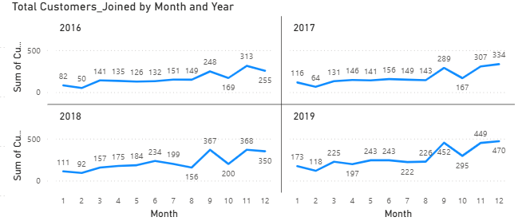
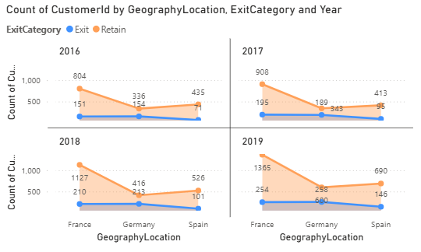
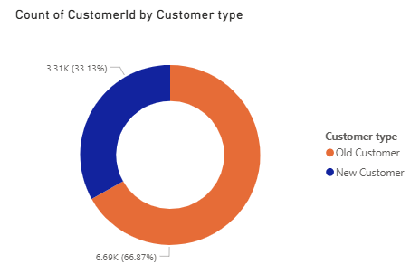
Total Customers joined monthly

Slide 17
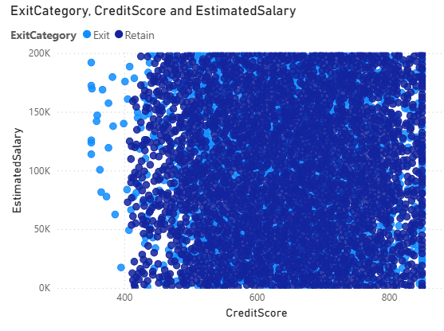
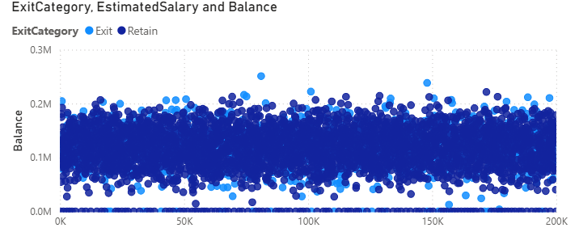
Correlation between Balance, Credit score and Salary
Customers who exited tend to have a lower sum of estimated salary and balance compared to retained customers.
However there are no outliers.
There is a positive correlation between the sum of estimated salary and the sum of balance.
This means that customers with a higher estimated salary also tend to have a higher balance.

Slide 18
KEY INSIGHTS
The poorest credit score segment (300-579) experiences the highest exit rate.
Possessing a credit card does not significantly affect churn rates.
The most common number of products among customers who have exited the bank is one.
Many customers join the bank during the months of August to December.
The highest churn rate and the lowest number of active members indicate that germany is a significant financial risk for the bank

Slide 19
The analysis clearly demonstrates that long-term customers exhibit stronger engagement, higher total product usage, and greater contribution to the organization’s product portfolio. While new customers show similar average product usage per individual, the cumulative impact of tenure significantly enhances overall customer value.
This pattern strongly suggests that customer loyalty increases over time and that strategic retention efforts can substantially improve long-term profitability.
The Product Affinity Study proves that customers are likely to adopt complementary banking products that facilitate their primary financial needs. By understanding these associations, financial institutions can develop accurate cross-selling initiatives to improve customer engagement and profitability. By leveraging behavioural knowledge and optimizing digital channels, banks can improve customer relationships, service personalization, and sustain long-term growth

Slide 20
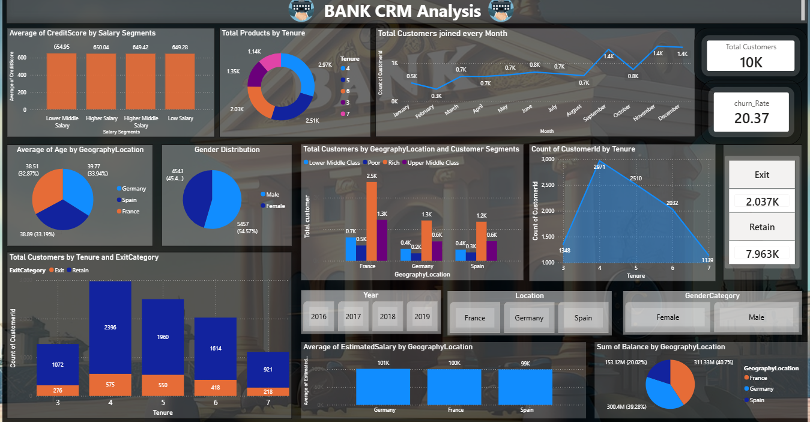
DASHBOARD

Slide 21
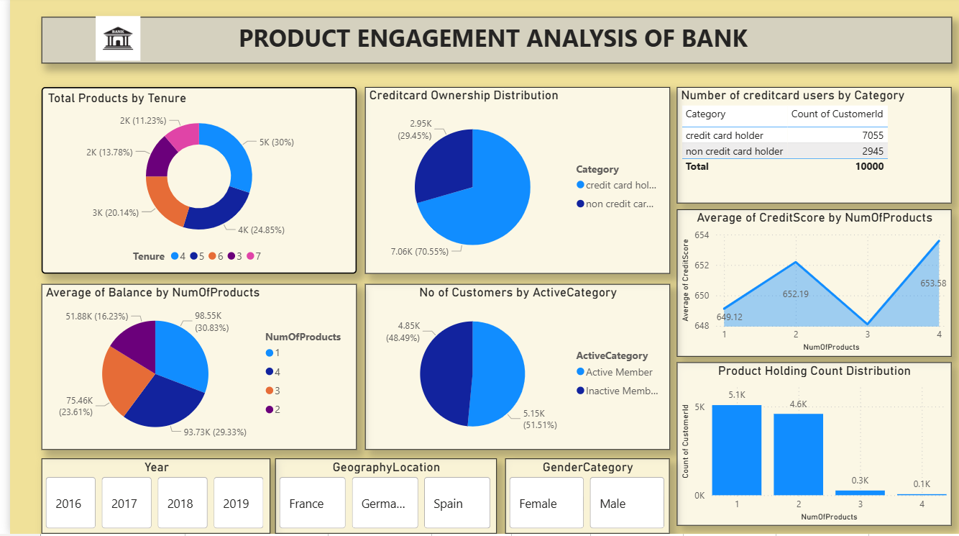

Slide 22
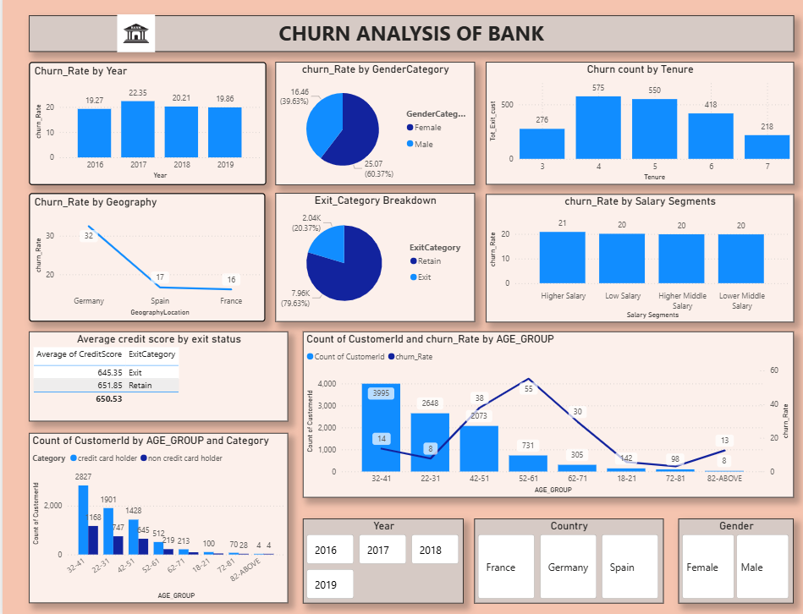

Slide 23
Strategies to Decrease Churn Rate
Promote Product Bundling: Incentivize multi-product adoption to deepen customer relationships and reduce exit risk.
Implement Retention Programs: Design loyalty schemes to increase tenure and lifetime value (CLV).
Enhance Customer Experience: Improve service quality and proactive engagement to boost satisfaction.
Leverage Customer Feedback: Use data-driven insights to refine and personalize product offerings.
Strengthen Credit Risk Controls: Focus lending on high credit-score customers to reduce defaults.
Accelerate Q1 Acquisition: Deploy targeted campaigns and incentives to expand the customer base early in the year.

Slide 24
Conclusion
The bank maintains a stable churn rate despite continuous growth in new customer acquisition.
Customers with lower credit scores and limited product adoption exhibit a higher probability of churn.
Middle-aged and senior customer segments demonstrate relatively higher churn, requiring targeted retention strategies.
Improving customer engagement, strengthening feedback mechanisms, and enhancing service quality are critical to boosting retention and loyalty.
Promoting bundled and multi-product offerings can increase product penetration and effectively reduce churn.

